Slide 1
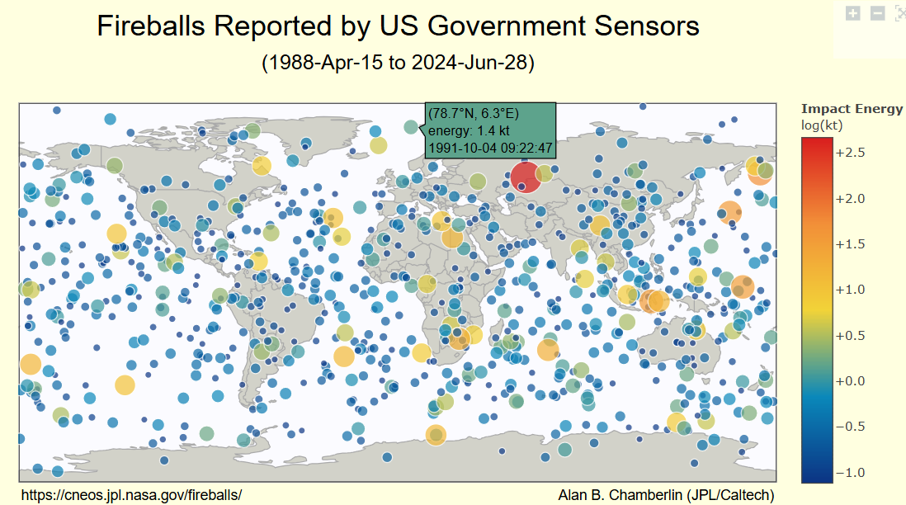
Fireballs and Bolide Data
The Geostationary Lightning Mapper (GLM) aboard the GOES East and West satellites captures data on natural lightning and bright meteors, known as bolides. Operational since December 2017 (GOES 16), February 2019 (GOES 17), and January 2023 (GOES 18), GLM provides continuous coverage focusing on the Americas. With its high-resolution staring CCD imager, the GLM can detect meteoroids from decimeter-size to potentially larger than a meter, capturing data at 500 frames per second.
The data is publicly accessible, including details on the date/time, geographic location, altitude, velocity, total radiated energy, and calculated total impact energy of each event. However, not all fireballs are reported, and some fields may be empty, requiring corrections for detailed studies.
Handling missing data involves using imputation techniques like interpolation or extrapolation for time-series data and statistical methods to estimate missing values. Data augmentation can also be employed by combining GLM data with other observational datasets to fill gaps. Despite GLM's capabilities, certain limitations exist, such as background subtraction errors, narrow bandpass energy reporting, view angle spectral response dependence, and parallax errors due to altitude assumptions.
Researchers must consider these factors when analyzing trends in bolide detections, mapping spatial distributions, and studying the impact energy distribution to ensure accuracy and reliability in their findings.

Slide 2
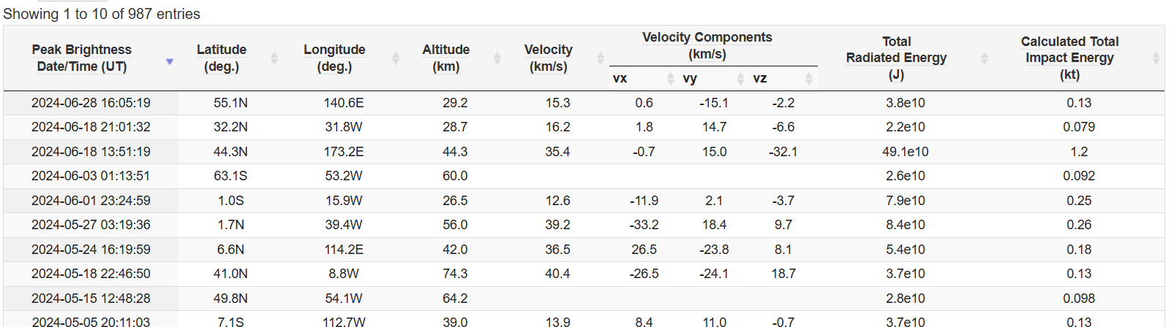
Data
Velocity Components (km/s) vx(671 fields missing) 316 entries
Velocity Components (km/s) vy(671 fields missing) 316 entries
Velocity Components (km/s) vz(671 fields missing) 316 entries
Total Radiated Energy (J) (all data complete)
Calculated Total Impact Energy (kt) (all data complete)
Time Frame: 15 April 1988 - 28 June 2024
Reported fields: 987 data entries/events
Peak Brightness Date/Time (UT) YYYY-MM-DD HH:MM:SS(all data complete)
Latitude (deg.) (190 fields missing) 797 entries
Longitude (deg.) (190 fields missing) 797 entries
Altitude (km) (459 fields missing) 528 entries
Velocity (km/s) (671 fields missing)

Slide 3
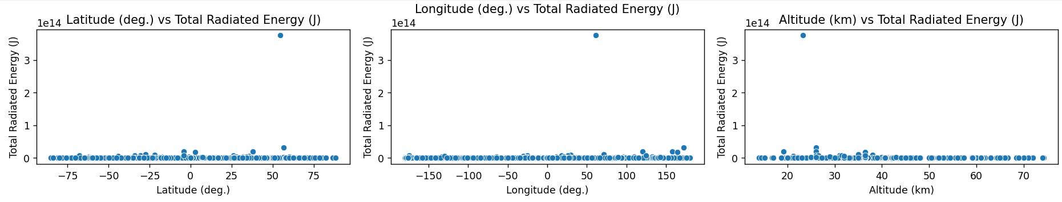
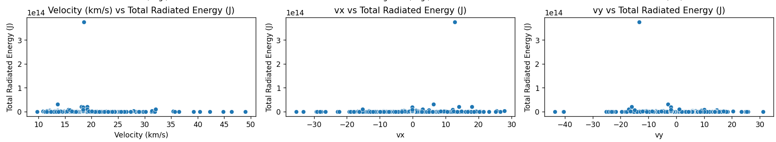
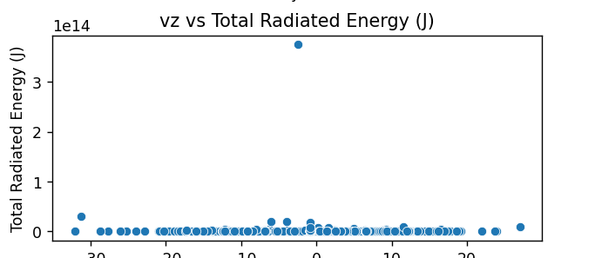
Fireballs and Bolide Data

Slide 4
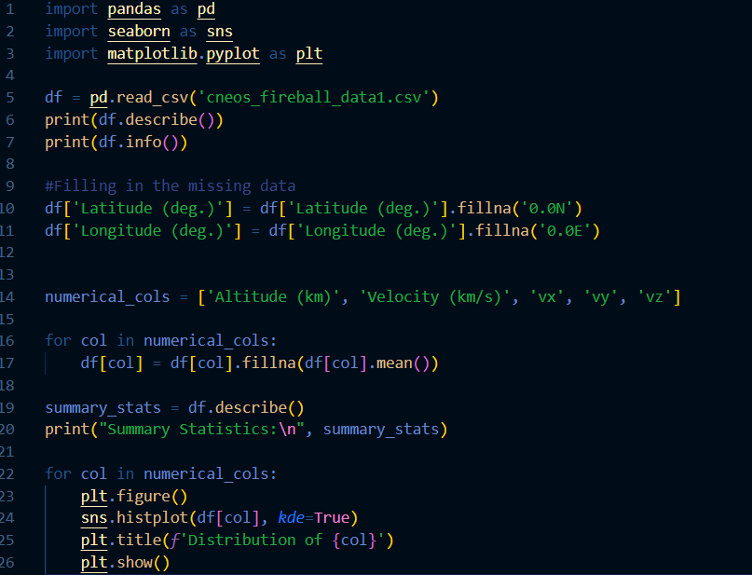
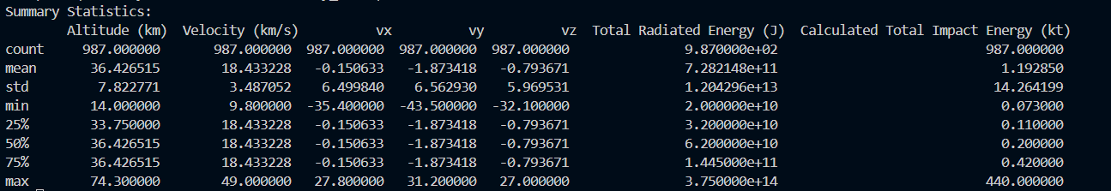
Summary Statistics – Means – Standard Deviations
Replace Missing values
Replace Latitude and Longitude values with ‘0.0N’ and ‘0.0E’, respectively
Fill all other fields’ missing values with their respective means

Slide 5
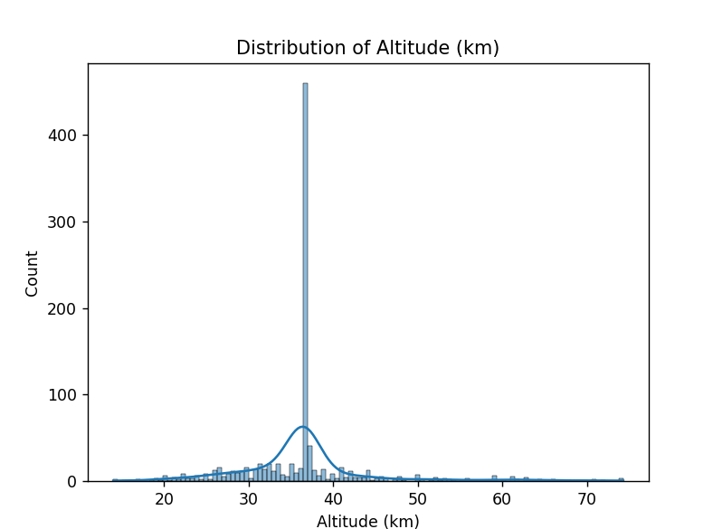
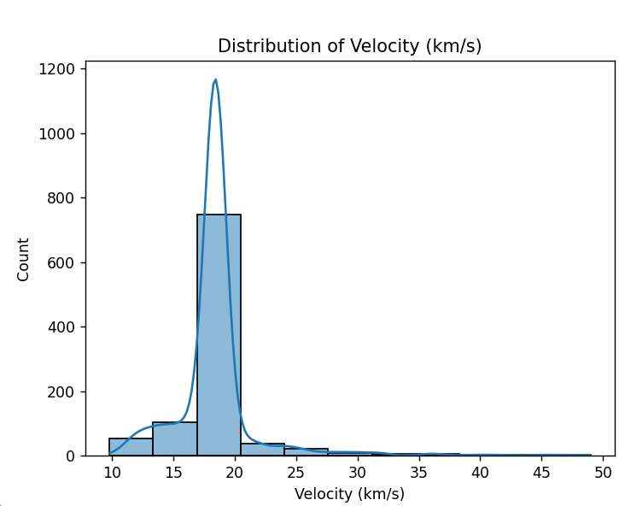
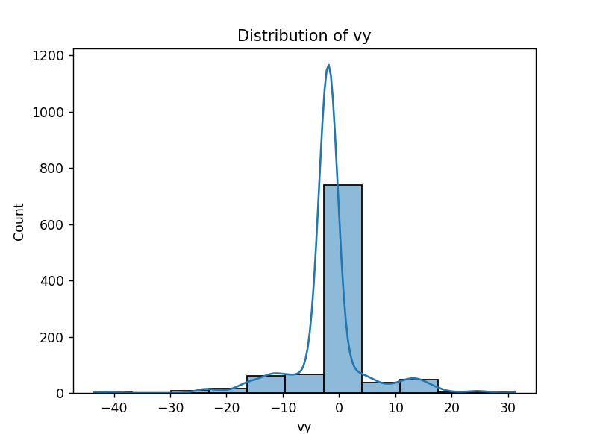
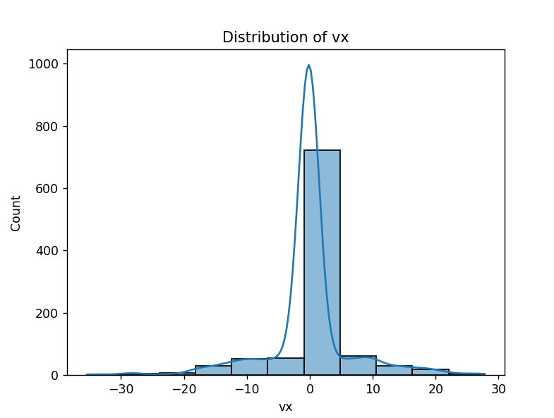
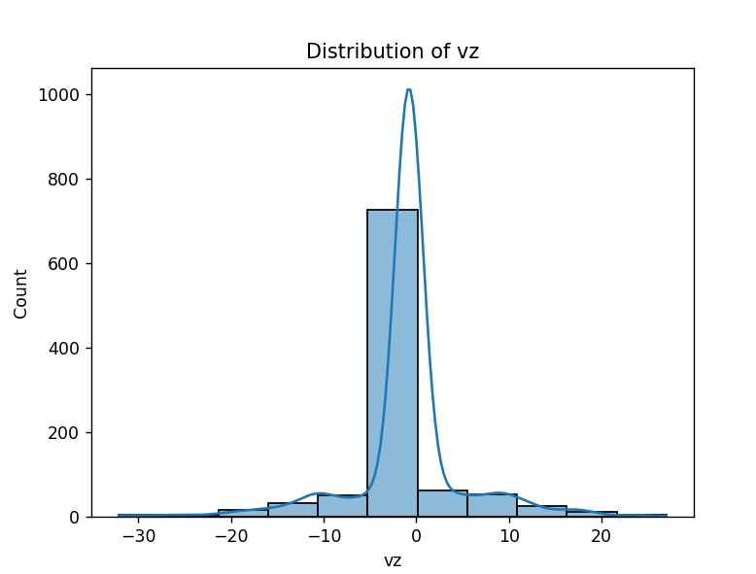
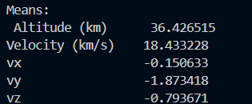
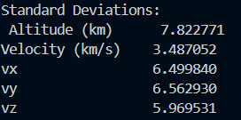
Kernel Density Estimates Histograms

Slide 6
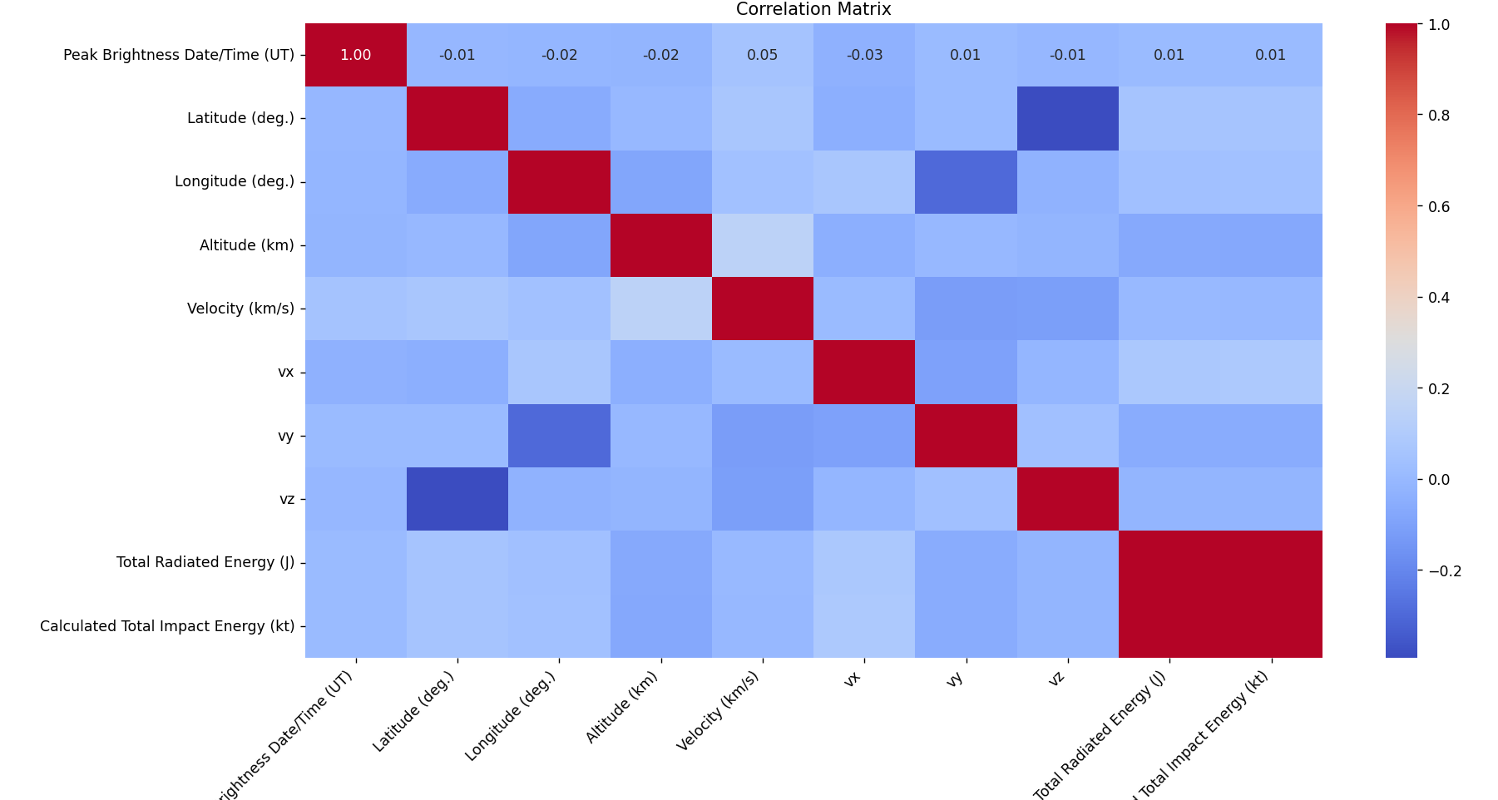
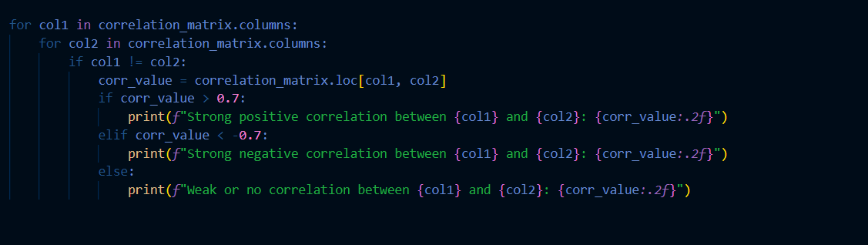
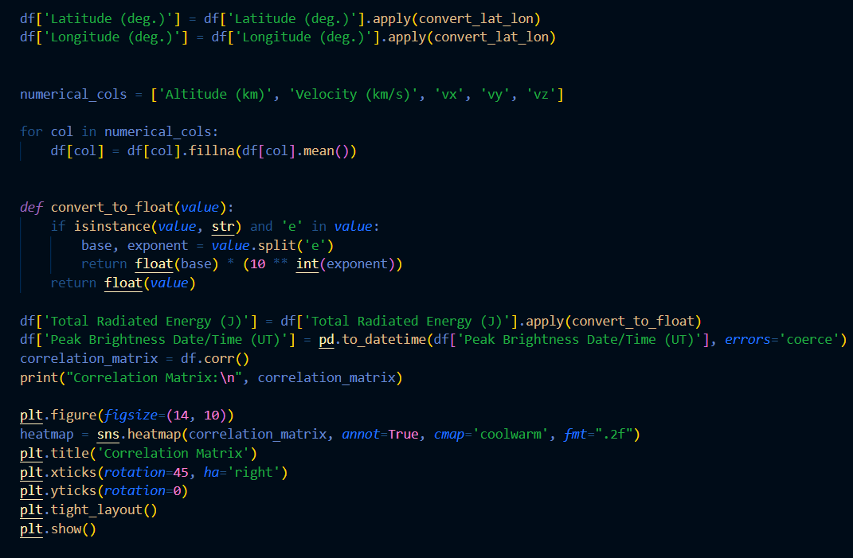
Correlation Analysis
Perfect Positive Correlation
Total Impact Energy & Total Radiated Energy
Perfect Negative Correlation
Latitude & vz
Longitude & vy

Slide 7
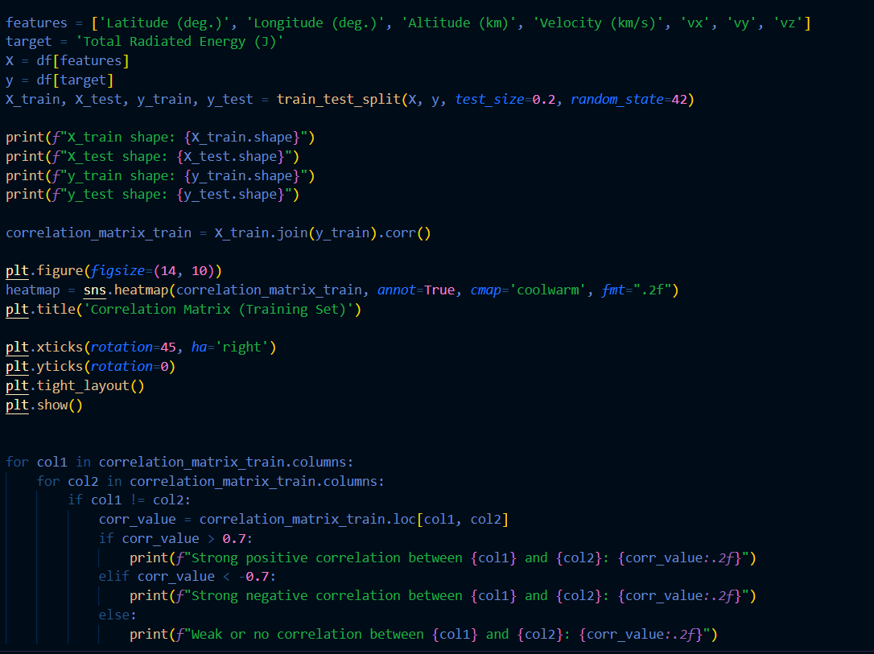
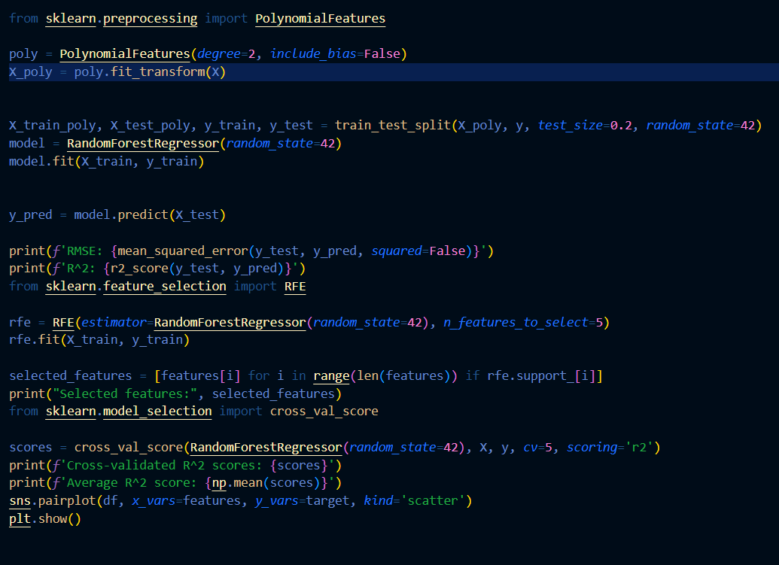
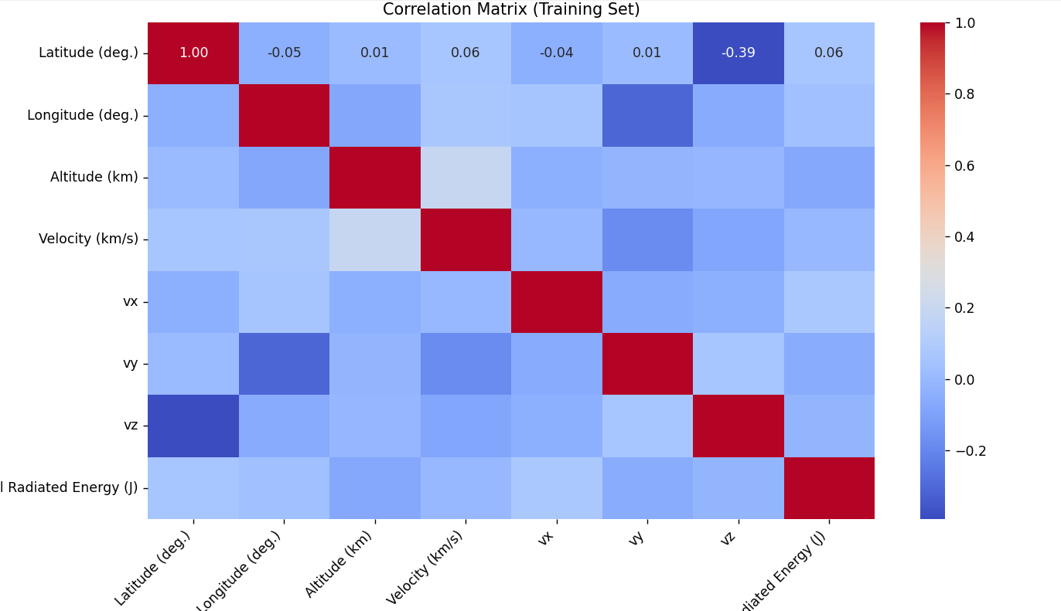
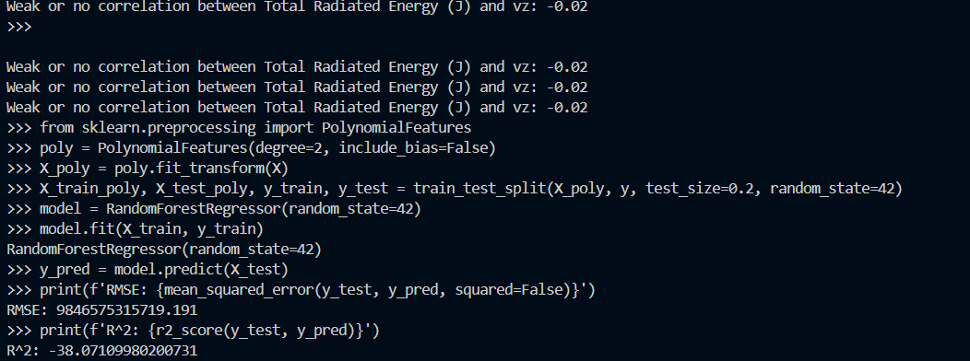
Train Test Split
Perfect Negative Correlation
Train and Evaluate with Linear Regression, Ridge, Lasso, Random Forest
Retrieve R^2 values
Perform Cross Validation

Slide 8
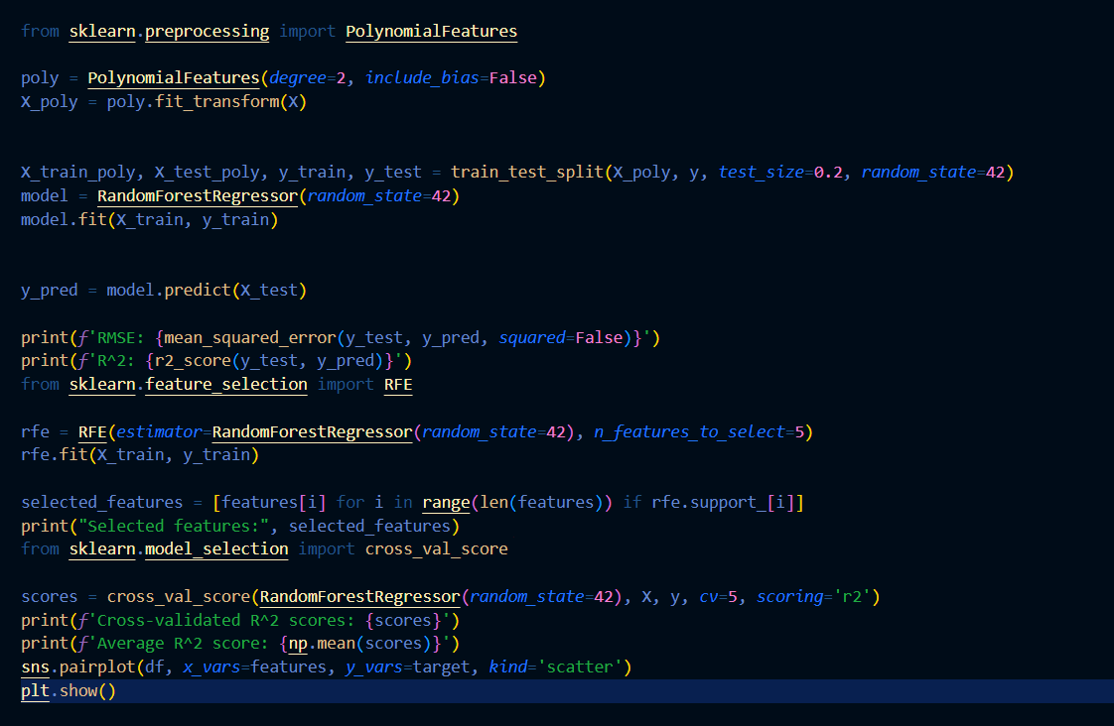
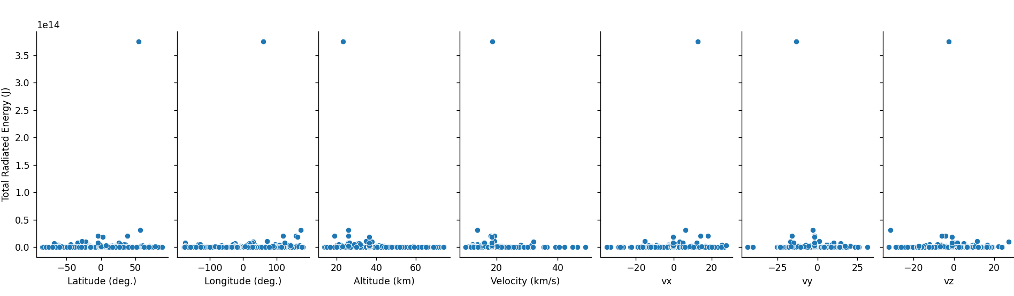
Anticipated Poor Results
Random Forest Regression R^2 Score: -38.071
Cross Validation Average R^2 Score: -65.70889

